Slide 1
PBL Secondary Research Report
FPGA-Based Hamming Code Error Detection and Correction System
A comprehensive study of Hamming code theory, design, and FPGA implementation
Team member detaIls:
MANVITH 4SO24EC066
JOEL ANSTON DSOUZA 4SO24EC064
MANISH 4SO24EC049
MEGHRAJ POOJARY 4SO24EC068

Slide 2
Chapter 1: Introduction
Background
Error detection and correction are critical functions in modern digital communication systems. As data travels across noisy channels — whether wired, wireless, or optical — bit errors inevitably occur due to electromagnetic interference, Richard Hamming developed the Hamming Code in 1950 while working at Bell Labs. The idea came from the need to detect and correct errors occurring during data transmission and storage in computers and communication systems.
In digital communication, binary data (0s and 1s) can become corrupted because of:
Electrical noise
Signal interference
Hardware faults
Weak transmission channels
Even a single bit change can produce incorrect information. To improve reliability, error-control techniques are used.
.
Problem Statement
In digital communication systems, the following key problems motivate this project:
Data corruption occurs due to noise and electromagnetic interference in transmission channels.
Simple parity methods can only detect errors but cannot locate or correct them.
More complex ECC schemes exist but introduce significant hardware overhead.
There is a need for a system that balances error correction capability, hardware complexity, and processing speed — particularly for FPGA deployment.
1.3 Objectives
This project aims to achieve the following:
To understand the basic concept of Hamming Code.
To learn how errors occur during data transmission.
To study the role of parity bits in error detection.
To understand how single-bit errors can be corrected using Hamming Code.
To analyze the importance of error detection and correction in digital communication systems .
Chapter 2: Literature Review (Secondary Research)
2.1 Review of Existing Work
A systematic review of existing literature on Hamming code implementations and FPGA-based error correction systems was conducted. Three major categories of work were identified:
Paper 1: Basic Hamming Code Implementation
The foundational approach uses the standard (7,4) Hamming code where 4 data bits are encoded into a 7-bit codeword using 3 parity bits. ,

Slide 3
. The main limitation is that only single-bit error correction is supported, and the syndromes are calculated in sequential order,this sequential syndrome calculation results in relatively slower processing speed.
Strength: Minimal hardware resources, simple design.
Limitation: Slower speed; only corrects one-bit errors.
Paper 2: FPGA-Based Error Correction System
An encoder is a digital tool that takes your original data and adds extra "helper bits" to create a protected package. These extra bits follow a mathematical rule so the receiver can spot if a mistake happened during the trip. It essentially builds a secret map that allows the computer to find and fix any broken pieces of information..
Paper 3: Building a Digital Fixer This paper is more like a DIY project where the authors actually built a "fixer" machine using a special chip called a CPLD. They explain a specific version called the "(7, 4) Hamming Code," where they take 4 bits of real data and add 3 "helper" bits (parity bits) to make a 7-bit package. They show that this method is very fast and reliable for modern electronics like CD players or cell phones.
2.2 Comparative Analysis
These three papers examine Hamming codes through mathematical logic, theoretical redundancy systems, and physical hardware implementation on CPLD chips. They focus on correcting single-bit errors but overlook "burst errors" where multiple pieces of data fail simultaneously. Future research is needed to improve battery efficiency for mobile devices and protect these systems from intentional security hacking.
2.3 Research Gap Identification
These papers focus almost entirely on Single Error Correction (SEC). In real-world high-speed networks, errors often happen in "bursts" (many bits at once), which standard Hamming code cannot fix
Although Paper 3 discusses hardware, it does not measure how much battery power the error correction process uses, which is critical for mobile devices and IoT sensors
Security Gaps: The papers treat errors as accidental "noise". There is little discussion on intentional errors (hacking), where someone might purposefully flip bits to corrupt a message or bypass security.

Slide 4
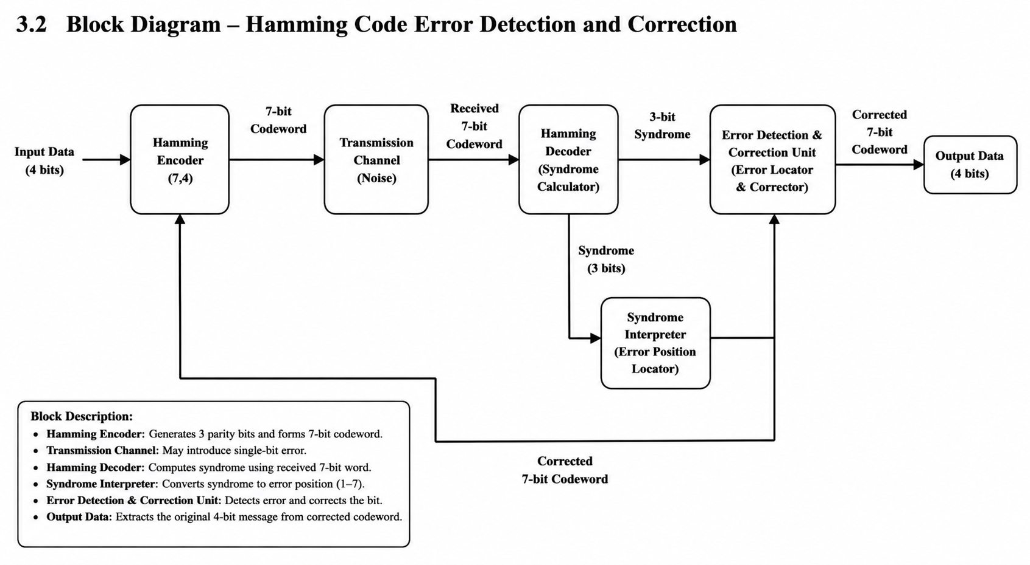
Design Justification
The block diagram was selected because it provides a systematic way in which the hamming encoder and decoder actually works .it has made the conceptual learning easy.

Slide 5
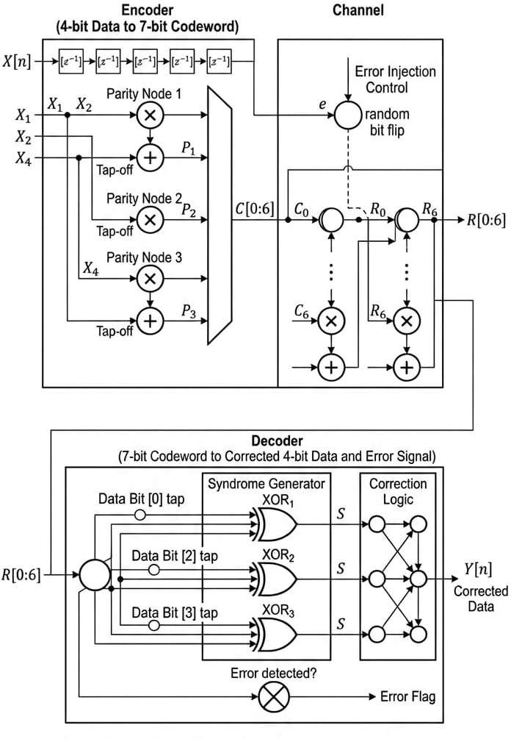

Slide 6
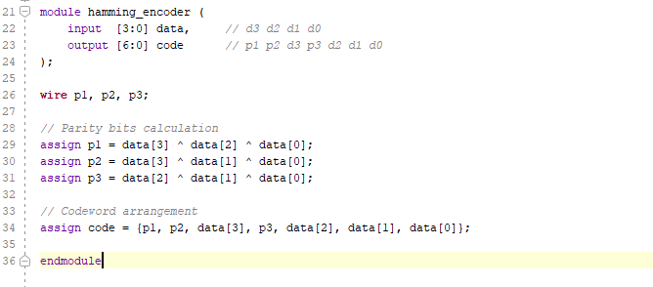
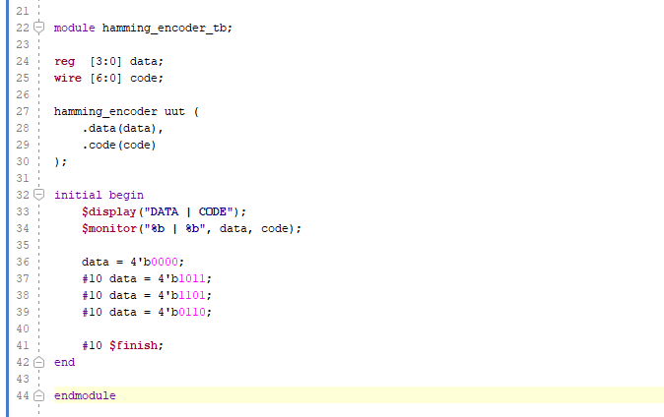
Leaf cell simulation

Slide 7
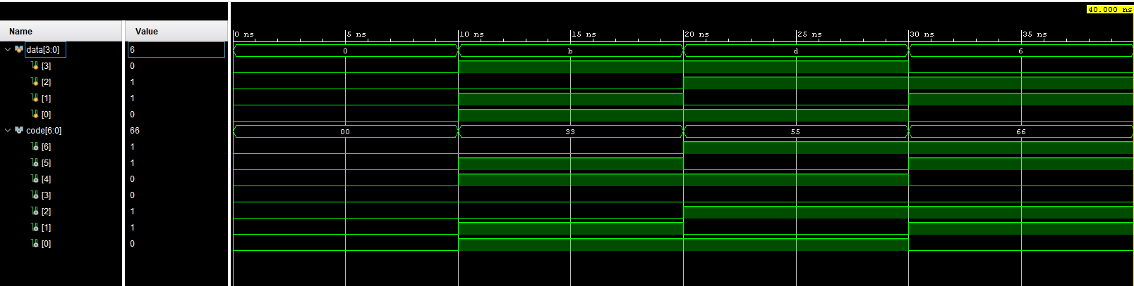
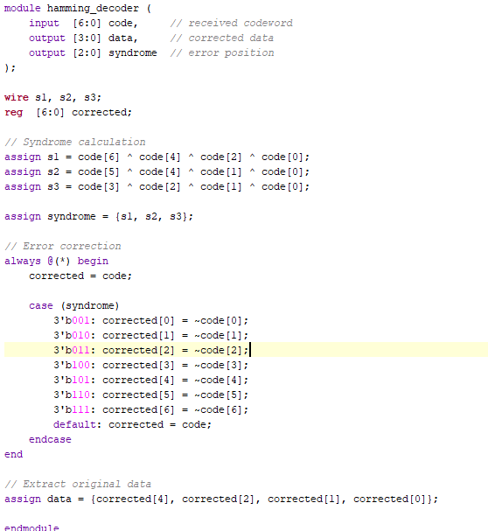

Slide 8
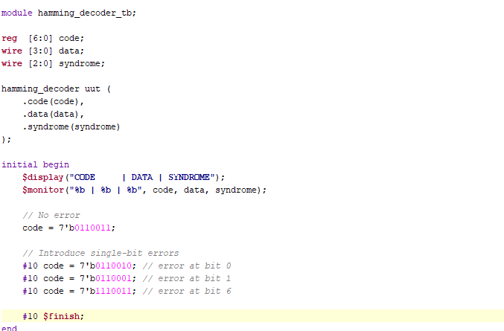
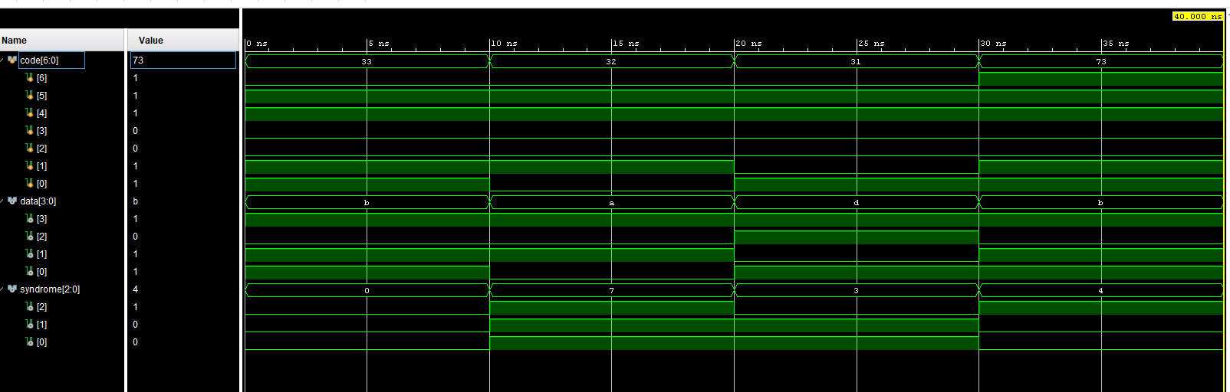

Slide 9
References
R. W. Hamming, "Error Detecting and Error Correcting Codes," Bell System Technical Journal, vol. 29, no. 2, pp. 147–160, Apr. 1950.
A. K. Singh, "Error Detection and Correction by Hamming Code," in Proc. 2016 International Conference on Global Trends in Signal Processing, Information Computing and Communication, IEEE, 2016, pp. 35–37.
C. Hillier and V. Balyan, "Error Detection and Correction On-Board Nanosatellites Using Hamming Codes," Journal of Electrical and Computer Engineering, Hindawi, vol. 2019, Article ID 3905094, 15 pages, 2019.
G. Subhasri and N. Radha, "VLSI Design of Parity Check Code with Hamming Code for Error Detection and Correction," in Proc. International Conference on Intelligent Computing and Control Systems (ICICCS 2019), IEEE, 2019, pp. 15–20.
S. Haykin and M. Moher, Communication Systems, 5th ed. Hoboken, NJ: John Wiley & Sons, 2009.
Xilinx Inc., Vivado Design Suite User Guide: Logic Simulation, UG900, 2021. [Online]. Available: https://www.xilinx.com
7] M. D. Ciletti, Advanced Digital Design with the Verilog HDL, 2nd ed. Upper Saddle River, NJ: Pearson Prentice Hall, 2011.

